Slide 1
Forest Cover Type Classification With Deep Learning
George Chadwick-Jones
Using neural networks to predict forest cover types from environmental and geographical features

Slide 2
Objectives
Explore the structure and distribution of the dataset
Preprocess the environmental and geographical features for neural network training
Compare different neural networks architectures and parameters
Use the strongest performing models as inspiration for the final model
Evaluate how consistently the final model performs across the 7 classes of forest cover type.

Slide 3
Dataset and Preprocessing
581,012 observations
54 predictor variables
7 forest cover classes
Environmental and geographic features including:
  Elevation
  Slope
  Aspect
  Distances to hydrology, roads and fire points
  Measurements of hillshade
  soil-types
Preprocessing:
The dataset had no missing values or duplicate observations
Dataset was split into 70% training, 15% validation, 15% test
Stratified splitting was used to maintain the class distributions
Features were standardised using StandardScaler()

Slide 4
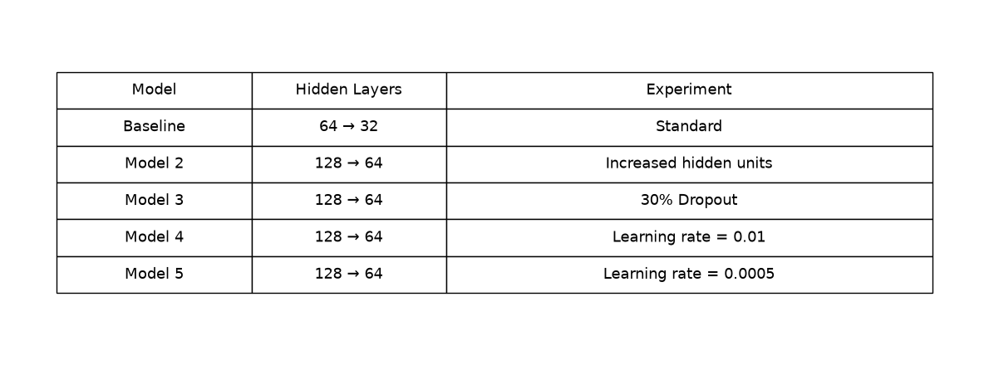
Model Development
Five initial neural networks were created to investigate different architectures and hyperparameters, with the validation data being used to assess the effectiveness of each network.
Common settings:
ReLU activation in hidden layers
Softmax output layer with 7 classes
Adam optimiser
Sparse categorical cross-entropy
Batch size: 128
Early Stopping to reduce overfitting

Slide 5
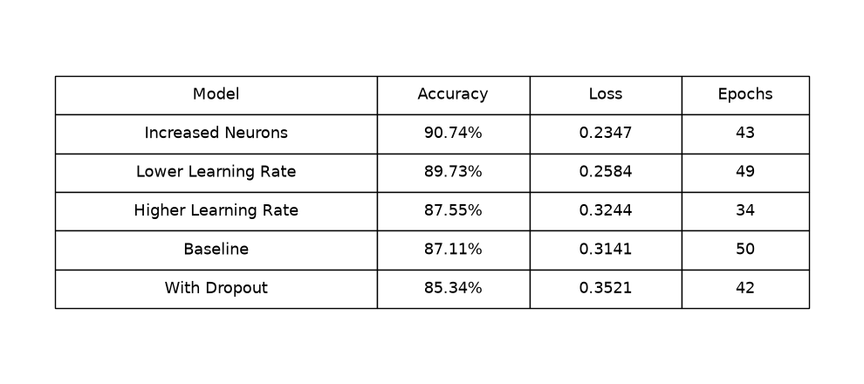
Model Development – Results
The five initial models produced noticeably different results despite using the same training set.
The strongest initial model came from increasing the number of hidden units from 64 → 32 to 128 → 64. This model achieved an accuracy of 90.74%, outperforming the baseline model by 3.63%.
The model with a lower learning rate also performed well, having achieved an accuracy of 89.73%, making it a useful addition in the final model.

Slide 6
Developing the Final Model
The results from the initial models were used to identify changes that could potentially improve the performance of the neural network.
Building on model 2:
Model 2 achieved the highest initial accuracy, so the number of hidden units were increased further from 128 → 64 to 256 → 128.
Model 5 had a lower learning rate than the other models at LR = 0.0005 and it achieved the second-highest accuracy, so it’s learning rate was adopted for the final model.
The maximum epochs for the final model were increased from 50 to 100, giving the larger network coupled with the lower learning rate of the final model more time to optimise. Model 5, trained for 49 out of the available 50 epochs, suggesting that the lower learning rate could benefit from a longer training window.

Slide 7
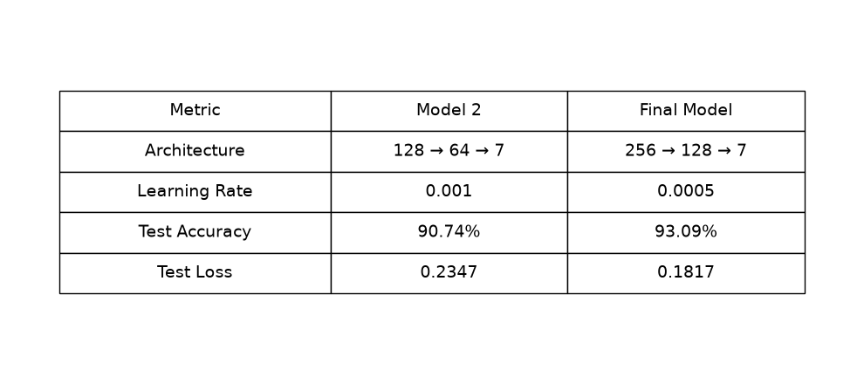
Final Model Performance
The final model was trained using an increased network capacity, lower learning rate and an increase number of epochs.
Final results
93.09% test accuracy
0.1817% test loss
The model achieved an additional 2.35 percent points in accuracy

Slide 8
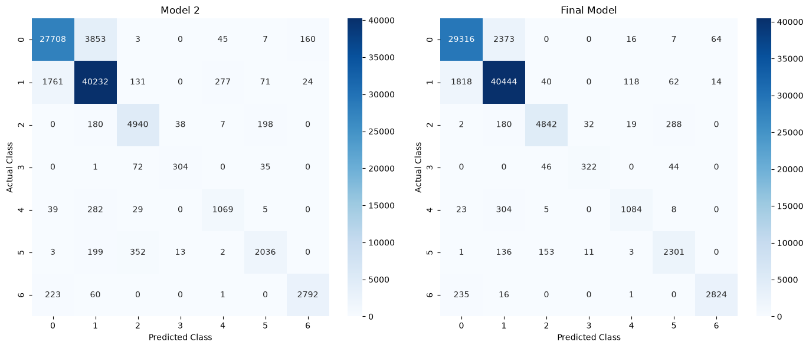
Class Level Performance
The final model was evaluated across each forest cover class using precision, recall and f1 score.
Performance was strongest for the majority classes in the dataset, paritularly classes 1 and 2.
The minority classes were more difficult for the model to classify accurately, as there is less data for the model to learn.
Class 5 had the lowest recall score at 76%

Slide 9
Key Findings and Limitations
Findings
The initial experiments showed that increasing the number of hidden units and decreasing the learning rate produced the strongest model performances
The final model achieved an accuracy of 93.09%, improving on model 2’s accuracy of 90.74%.
The final model achieved a strong performance across the majority of forest cover classes
The lowest performance was found in the minority classes due to a lack of information seen by the neural network, in particular model 5.
Limitations
The dataset contains a substantial class imbalance, which may bias the model towards the majority classes
Future iterations of the model could investigate class weighting or oversampling to improve the performance of the minority classes

